Slide 1
Managerial Decision Making
Chapter 4

Slide 2
Managerial Decision Making
Decision making is not easy
It must be done amid
ever-changing factors
unclear information
conflicting points of view

Slide 3
Definition : Decision Making
The process of identifying and selecting a course of action to solve a specific problem
Decision is a choice between two or more alternatives
Decision is on the basis of conscious logic
Decision must bring the organization closer to the goal

Slide 4
Components of Decision Making
Objective or Problem
Alternatives
Choice

Slide 5
Characteristics of Decision making
Existence of alternatives
Negative or positive
Freedom of choice
Result oriented
Intellectual process
Logical process
Continuous process
Situational

Slide 6
Importance of decision making
Leads to optimum utilization of resources
Core of Planning
Helps to attain objectives
Improves efficiency
Means to problem solving
Helps to face challenges
Leads to motivated and dedicated employees

Slide 7
Six Steps in the Managerial Decision-Making Process
❻
❶
Evaluation
and
Feedback
Defining and analyzing the problem
❷
Implementation
of Chosen
Alternative
Generating Alternative Solutions
Decision-Making
Process
❺
❺
❺
Selection of
Desired
Alternative
Evaluating
Alternatives
❸
❹

Slide 8
Types of Managerial decisions
Programmed and Non programmed
Personal and Organizational
Individual and Group
Routine and Strategic
Policy and Operating

Slide 9
Categories of Decision Making Techniques
Programmed Decision Making
Situations occurred often enough to enable decision rules to be developed and applied in the future
Made in response to recurring organizational problems
Non-programmed Decision Making
in response to unique, poorly defined and largely unstructured situations, and have important consequences to the organization

Slide 10
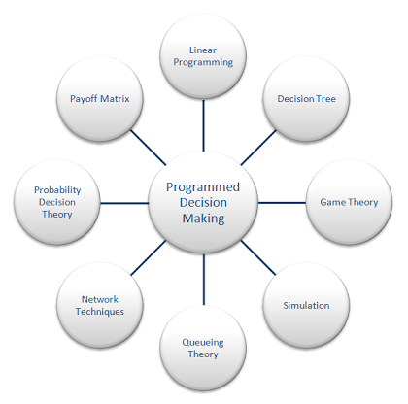
Programmed Decision Making Techniques

Slide 11
Linear Programming
a quantitative technique
used to decide how to distribute the limited resources for achieving the objectives
linear means the relationship between variables is staight, and programming means taking decisions systematically
used when two or more activities are competing for limited resources

Slide 12
Example of Linear Programming
You need to buy some filing cabinets. You know that Cabinet X costs $10 per unit, requires six square feet of floor space, and holds eight cubic feet of files. Cabinet Y costs $20 per unit, requires eight square feet of floor space, and holds twelve cubic feet of files. You have been given $140 for this purchase, though you don't have to spend that much. The office has room for no more than 72 square feet of cabinets. How many of which model should you buy, in order to maximize storage volume?
x: number of model X cabinets purchased y: number of model Y cabinets purchased
Naturally, x > 0 and y > 0
cost: 10x + 20y < 140 space: 6x + 8y < 72 volume: V = 8x + 12y

Slide 13
Game Theory
A game is a situation involving at least two people
Each person’s decision is based on what he expects the other to do
Used for deciding about competitive pricing
Both decision- makers adapt to each other's decisions

Slide 14
Payoff Matrix
A statistical technique, which helps managers to choose the best alternative.
Payoff is the return or reward for selecting the best alternative
Best alternative can be a combination of many alternatives or a single alternative

Slide 15
Game Theory -example
A river flows through two countries, A and B. It starts in country A, and then flows through B to the ocean. Both countries can either dam the river (and get electricity) or fish the river. If either country dams the river, it hurts the fish population in the river (either by decreasing the water flow downstream, or preventing fish from swimming upstream). So if one dams and the other fishes, it's bad for the one who fishes. If they both fish, it's good for both, but not as good as if they both dam, since the electric power is worth more than the fish.

Slide 16
Game theory –Payoff matrix
A Dams A fishes
B fishes B dams
+2,+2 | 0,+2
+2,0 | +1,+1

Slide 17
Simulation
used to decide about complex problems
effect of the decision is observed in a simulated situation and not in a real situation
find out the effectiveness of its new advertisement by first showing it to few people before telecasting it on TV

Slide 18
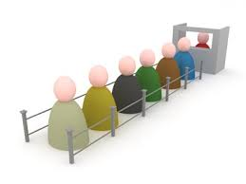
Queuing Theory
used to find solutions to the waiting list problems in case of airline reservations, railway reservations, college admissions, etc
helps to find out the optimum number of service facilities required and the cost of these services

Slide 19
Network Techniques
Network techniques like PERT (Program Evaluation Review Technique) and CPM (Critical Path Method) are used for complex projects, where many activities have to be completed
In CPM, the critical activities of a program or a project are identified. These are the activities that have a direct impact on the completion date of the project.
PERT is a method to analyze the involved tasks in completing a given project, especially the time needed to complete each task, and to identify the minimum time needed to complete the total project.

Slide 20
CPM and PERT
In the critical path method, the critical activities of a program or a project are identified. These are the activities that have a direct impact on the completion date of the project.
PERT is a method to analyze the involved tasks in completing a given project, especially the time needed to complete each task, and to identify the minimum time needed to complete the total project.

Slide 21
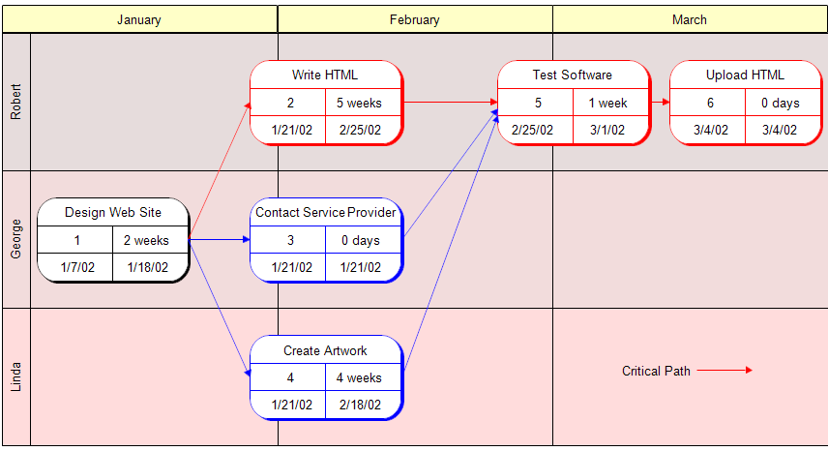
CPM-Website Design Process

Slide 22
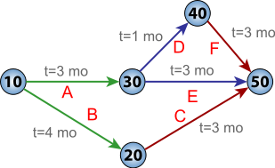
PERT

Slide 23
Probability Decision Theory
Based on the assumption that the future is uncertain
There is a chance that a certain event may or may not take place
Based on available data and subjective judgment of the manager, various probabilities are assigned (given) to alternative courses of action (decision)
The likely / possible outcomes of different alternatives are evaluated, and the most likely alternative is selected

Slide 24
Decision Tree
a diagram which shows all the possible alternatives of a decision
information can be seen at one glance
like a horizontal tree
base of the tree is called the Decision Point
from this point, the different alternatives and sub-alternatives are shown as branches and sub-branches
study all the alternatives very carefully and select the best alternative

Slide 25
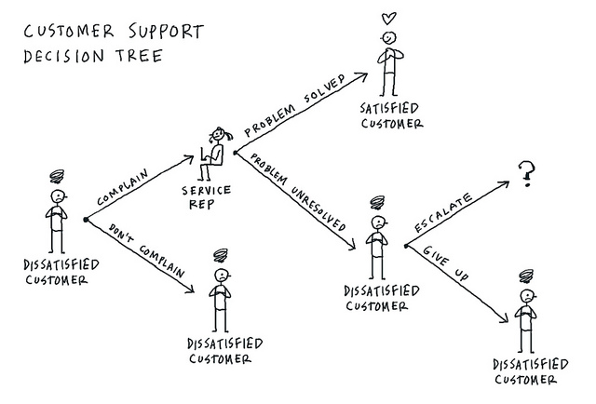
Decision tree

Slide 26
Non Programmed Decision Making Techniques
Brainstorming
Nominal Group Technique
Delphi Technique
Quality Circles
Heuristic Technique
Participative Technique

Slide 27
Brainstorming
Developed by Osborn, who is called ‘The Father of Brainstorming’
To improve problem solving by finding new or creative solutions
Five to ten persons
Leader of the group tells them the problem
All possible ideas are invited to solve the problem
All the ideas are discussed and analysed
The best idea is selected

Slide 28
Delphi technique
Similar to brainstorming technique, except that the group members do not meet face to face
Group members are located at different places
Questionnaires are used to collect information from the group members
Group members are not influenced by one another, since they do not meet fact to face

Slide 29
Nominal Group Technique
Group members think independently
Each person comes up with his own ideas
No interaction among the group members at the early stage
Interaction takes place only after the ideas are presented by every single member of the group

Slide 30
Quality Circles
started in Japan in the early 1960s
Is a small group of employees from the same department who volunteer to meet regularly in order to identify, analyze and to solve problems about their work

Slide 31
Heuristic Technique
decisions are made based on experience, rule of thumb, common sense, etc

Slide 32
Participative Technique
Employees also involved in decision making process
Promotes accountability and commitment
Increases employee motivation

Slide 33
Thank You

