Slide 1
Organising
Chapter 5

Slide 2
Definition
Process of
Identifying and grouping of the work to be performed
Defining and delegating responsibility and authority
Establishing a pattern of relationships for the purpose of enabling people to work most effectively together in accomplishing objectives
Louis Allen

Slide 3
Process of Organizing
Defining Organizational Goals
Identifying Activities
Grouping of Activities
Defining Authority
Delegating Authority
Establishing Relationships
Assigning duties
Coordination
Providing resources

Slide 4
Principles of Organizing
Unity of Purpose/Principle of objective
Authority and Responsibility
Scalar principle
Span of Control
Division of Work
Coordination of effort
Functional Definition
Principle of Exception
Simplicity
Flexibility

Slide 5
Delegation of Authority
A process by which a manager assigns tasks and authority to subordinates who accept responsibility for those jobs
Assigning authority formally

Slide 6
Elements of Delegation
Authority
Right to give orders and power to exact obedience
Responsibility
Obligation of a subordinate to perform the duty as required by his superior
Accountability
Obligation of an individual to report formally to his superior about the work he has done to discharge the responsibility

Slide 7
Delegation of Authority : Process
Assign Duties
What, When,How?
How much resources?
Transfer of Authority
To enable subordinate to take right decision at the right time
Acceptance condition
If he/she rejects the process of delegation starts again
Creation of Responsibility
Both delegator and delegatee responsible

Slide 8
Importance of Delegation
Enables superior complete challenging jobs
Allows quick action
Facilitates training and development
Leads to motivation
Improves superior subordinate relationships
Enhances team spirit
Facilitates Performance Appraisal
Job satisfaction

Slide 9
Barriers of Effective Delegation
On the part of Superior
On the part of Subordinate

Slide 10
Barriers of Effective Delegation Difficulties of Superior
Fear of being exposed
Fear of losing control
Lack of confidence in subordinates
Lack of ability to direct
Desire to dominate
‘I can do it better’ feeling

Slide 11
Barriers of Effective Delegation Difficulties of Subordinate
Fear of criticism
Fear of losing job
Lack of information and resources
Lack of self confidence
Lack of incentives
Undue interference by superiors
Overdependence on superiors

Slide 12
Centralization
Centralization and Decentralization refer to the location of decision making authority
Centralization: Concentration of authority at the top level of the organization
Decentralization: Dispersal of authority throughout the organization

Slide 13
Decentralization
Dispersing decision making authority in an organization structure
Dispersal of authority throughout the organization
Control over activities is in the hands of the manager who is given the authority
More stable than delegation
Not possible without delegation

Slide 14
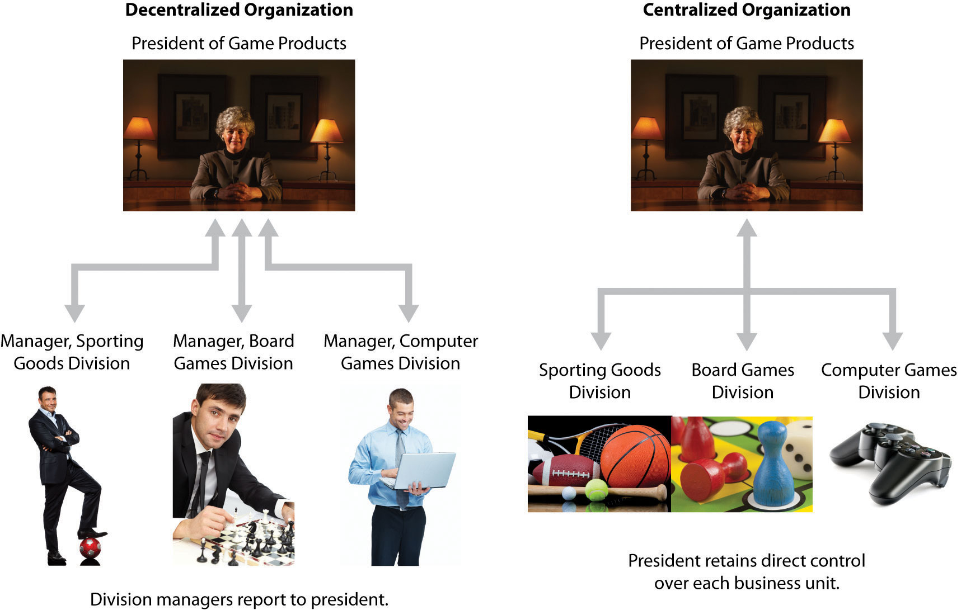

Slide 15
Differences between Centralization and Decentralization
Nature of Decisions
Size of the organization
Managerial requirement
Operating expenses and cost
Division of labour and specialization
Control

Slide 16
Factors affecting Centralization and Decentralization
History of the organization
Organization’s size
Nature of business
Management by exception
Degree of diversification of product lines
Well organized control system
Complication of jobs
Availability of capable administrators
Cost and significance of decisions
Management philosophy

Slide 17
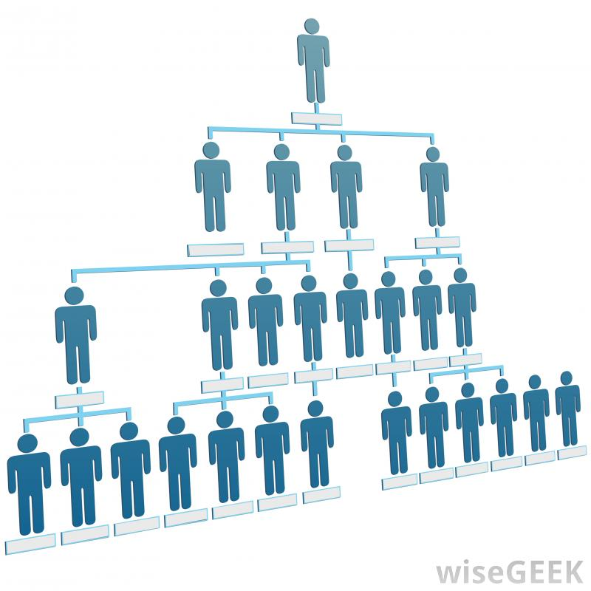
Span of Management/Control
Number of subordinates who can be supervised and managed effectively
Limit to maximum number of subordinates required in certain situations

Slide 18
Factors determining Span of Control
Capacity of manager
Capacity of Subordinates
Nature of work performed by subordinates
Extent of Decentralization
Degree of Planning
Communication system
Level of management
Geographic continuity

Slide 19
Graicunas Theory of Span of Control
Superior has three kinds of relationship with his/her subordinates
Direct relationship
Direct group relationship
Cross relationship
As the number of subordinates increases arithmetically , the number of relationships to be managed by the superior increases almost geometrically

Slide 20
Graicunas Formula
-
-
r = number of relationships
n= number of subordinates
No of Subordinates | No. of relationships
1 | 1
2 | 6
3 | 18
4 | 44
5 | 100
6 | 222

Slide 21
Thanks

